Slide 1

Vue.js - 3
Vue – Composition API, Vue-Router & Pinia
Basic to Advance

Slide 2

What is Vue.js?
Vue.js
Vue is a popular JavaScript framework for building user interfaces.
It builds on top of standard HTML, CSS, and JavaScript.
It provides a declarative and component-based programming model which allows developers to create interactive and reusable components for building modern web applications.

Slide 3
What is Vue.js?
Vue.js
Declarative Rendering
Vue.js uses a declarative approach to building UIs. You describe the structure of your UI in the HTML, and Vue.js takes care of updating the DOM to match the data state.
Vue
JavaScript
// Html
<h1>{{ title }}</h1>
// Js
const title = ref('Vue App')
// Html
<h1 id=“title”></h1>
// Js
const title = ‘JS App’
document.getElementById(‘title’).innerHTML = title
If title value is updated, Html DOM will be updated automatically.

Slide 4
What is Vue.js?
Vue.js
Component-based programming
Vue.js follows a component-based architecture, where the user interface is broken down into reusable and self-contained components.
Sign Up
ButtonComponent.vue
Sign In
Name
Submit
Enter Email
Email
Enter Password
Password
Submit
Submit

Slide 5
Prerequisites
Vue.js
HTML
CSS
JavaScript fundamentals & ES6

Slide 6
Development Environment
Vue.js
Node – (npm)
Text Editor ( Visual Studio Code)
Chrome Extension
Vue.js devtools
VS Code Extension
Volar
Vue VsCode Snippets

Slide 7
Vue.js Installation – 5 ways
Vue.js
1. CDN (Content Delivery Network)
2. npm (Node Package Manager)
<script src="https://unpkg.com/vue@3/dist/vue.global.js"></script>
> npm install vue@latest

Slide 8
Vue.js Installation – 5 ways
Vue.js
3. Vue CLI (Command Line Interface) – error cuz of maintenance
4. Vite
5. Official Vue project scaffolding tool
> npm install -g @vue/cli
> vue create <project-name>
> npm create vite@latest
> npm create vue@latest

Slide 9
Project Structure
Vue.js
public/ …
src/
assets/
components/
App.vue
main.js -------------------> Entry Point
index.html
package.json

Slide 10
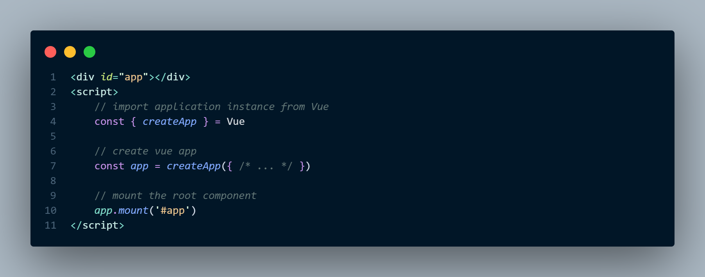
Creating an Application – 3 steps
Vue.js
CDN –

Slide 11
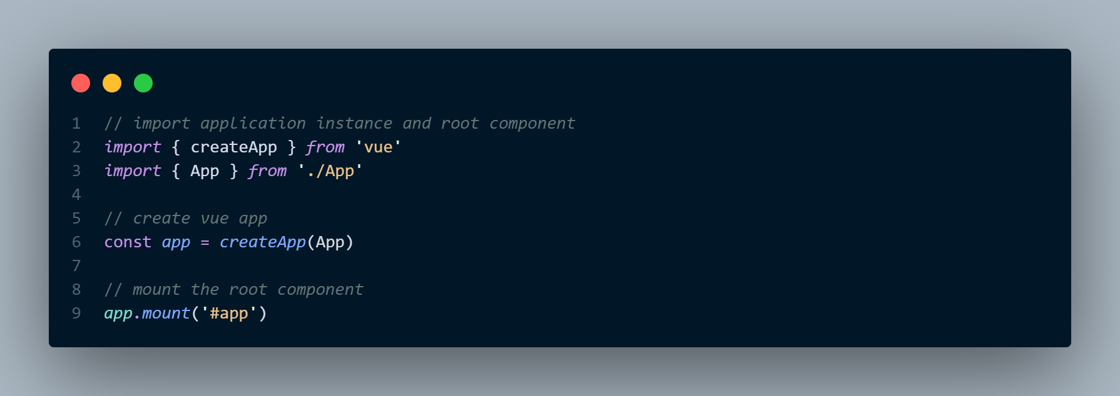
Creating an Application – 3 steps
Vue.js
Official Vue Project –

Slide 12
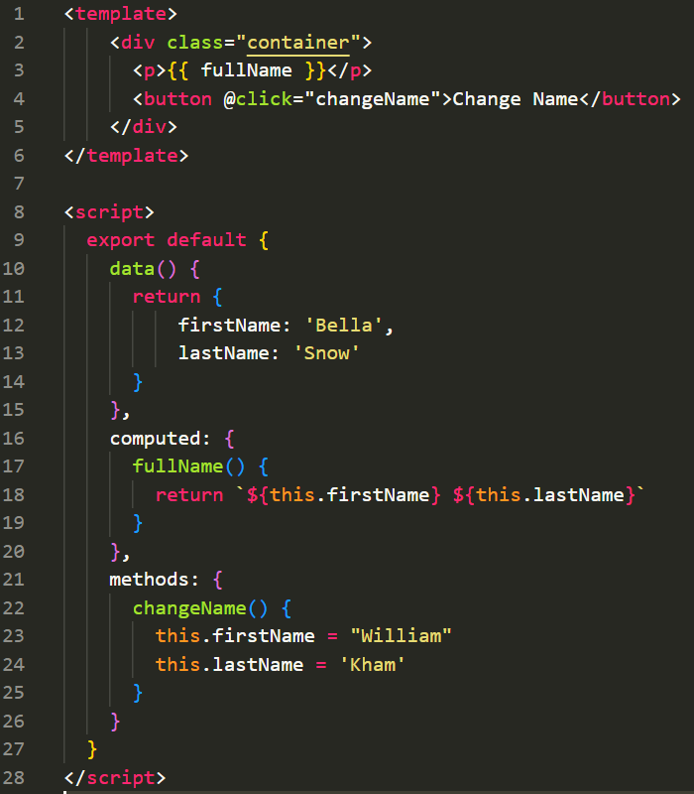
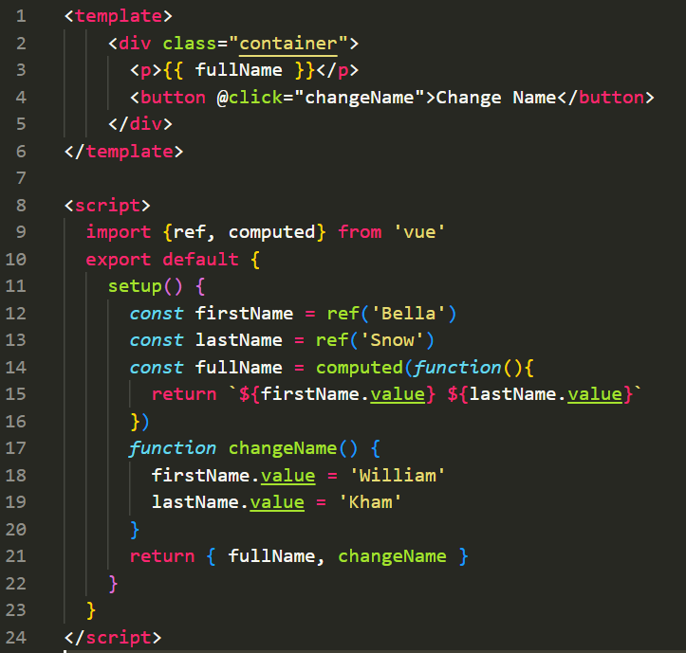
Option API vs Composition API
Vue.js
Composition API
Option API

Slide 13
Option API vs Composition API
Vue.js
Composition API

Slide 14
Setup
Vue.js
The setup() hook serves as the entry point for Composition API.
# html
- You can access variables and functions here
# js
setup() {
- variables
- functions
// expose to template
return { variables, functions }
}

Slide 15
Ref and Reactive
Vue.js
Reactivity is a key feature that allows Vue to automatically update the DOM (Document Object Model) whenever the underlying data changes.
- Use ref for primitive values (e.g., strings, numbers).
- Use reactive for objects and arrays

Slide 16
Ref and Reactive
Vue.js
ref()
reactive()
# html
<div>{{ name }}</div>
# js
import { ref } from 'vue'
const name = ref(‘Emma’)
console.log(name.value) // Emma
# html
<div>{{ person.name }}</div>
# js
import { reactive } from 'vue'
const person = reactive({ name: ‘Emma’, age: 20 })
console.log(person.name) // Emma

Slide 17
Binding Text
Vue.js
# html
<div>{{ var }}</div>
<div v-text=“var”></div>
# js
const var = ref(‘Hello Vue’)

Slide 18
Binding HTML
Vue.js
# html
<div v-html=“aTag”></div>
# js
const aTag = ref(“<a href="#">Link</a>”)

Slide 19
Attribute Binding
Vue.js
- Mustaches – {{ }} cannot be used inside HTML attributes. Instead, use a v-bind directive:
# html
<div v-bind:id="myId"></div>
// short hand
<div :id="myId"></div>
# js
const myId = ref('header-section’)
Boolean Attributes

Slide 20
Boolean Attributes
Vue.js
# html
<button :disabled="isBtnDisabled">Submit</button>
# js
const isBtnDisabled = ref(true)

Slide 21
Class Binding
Vue.js
# html
<p :class=“textColor">Hello Vue</p>
# style
.textColor { color: red }
# html
<p :class=“{red: active}">Hello Vue</p>
# js
const active = ref(true)
Binding to Objects
# html
<div :class="[one, two]">Hello Vue</div>
# style
.one { color: red }, .two { font-style: italic }
Binding to Array

Slide 22
Style Binding
Vue.js
# html
<div :style="{ color: activeColor, fontSize: fontSize + 'px' }">Hello Vue</div>
# js
const activeColor = ‘red’; const = fontSize = ‘30’;
Binding to Object
# html
<div :style="[styleOne, styleTwo]"></div>
# js
const styleOne = reactive({ color: ‘red’ })
Binding to Array

Slide 23
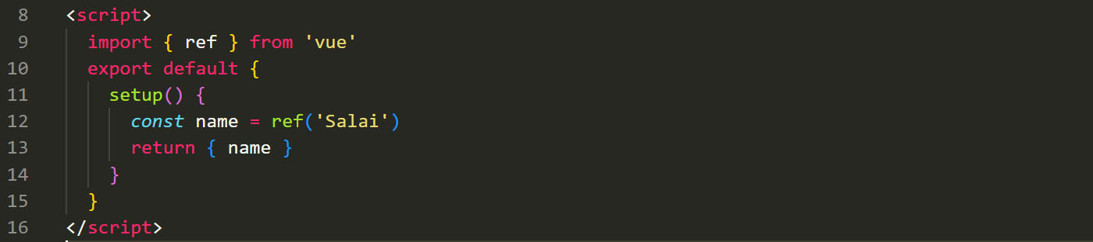
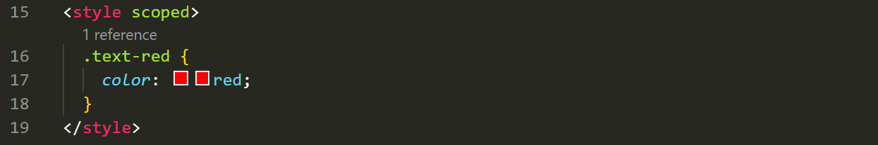
Component (or) .vue file
Vue.js
- To achieve this, we have to download Vue Project!
HTML
JS (Vue)
CSS

Slide 24
Conditional Rendering
Vue.js
v-if Directives
v-if
v-else
v-else-if
v-show
The difference is that an element with v-show will always be rendered and remain in the DOM.
v-show only toggles the display CSS property of the element.
v-show doesn't support the <template> element, nor does it work with v-else.

Slide 25
Conditional Rendering
Vue.js
v-if on Template
<template v-if=“isTrue”>
…
…
</template>

Slide 26
<script setup>
Vue.js
# Html
<p> {{ name }} </p>
<script setup>
import { ref } from 'vue'
const name = ref(‘John Doe’)
</script>

Slide 27
Accessing ref and reactive inside JS and template
Vue.js
# Html
<p> {{ name }} </p>
# Js
const name = ref(‘Bella’)
console.log(name.value) // Bella
# Html
<p> {{ person.name }} </p>
# Js
const person = reactive({ name: “Bella”, age: 20 })
console.log(person.name) // Bella

Slide 28
List Rendering
Vue.js
v-for Directive
- We can use v-for directive for the following …
Array of strings
Array of Objects
Array of arrays
An Object

Slide 29
Conditional List Rendering
Vue.js
v-for with v-if Directive
- We can’t do like that
<li v-for="user in users" v-if="user.single"> ... </li>
- We must do like that, instead
<template v-for="user in users">
<li v-if="user.single"> ... </li>
</template>

Slide 30
Method
Vue.js
# html
{{ fullName() }}
# js
function fullName() {
return “Bella Snow”
}
(or) using ES6 –
const fullName = () => {
return “Bella Snow”
}

Slide 31
Accessing data in methods
Vue.js
# html
{{ fullName() }}
# js
const firstName = ref(‘Bella’)
const lastName = ref(‘Snow’)
const fullName = () => {
return firstName.value + lastName.value;
}

Slide 32
Event Handling – Inline Handler
Vue.js
# html
<button v-on:click=“alert(‘u fire an event!’)">Click Me</button>
# js
// …
shorthand
@click=“…”

Slide 33
Event Handling – Method Handler
Vue.js
# html
<button @click="fireMe()">Click Me</button>
# js
const fireMe = () => {
alert('u fire an event!')
}

Slide 34
Event Handling – Native Event Argument
Vue.js
# html
<button @click="fireMe($event)">Click Me</button>
# js
const fireMe = (e) => {
console.log(e)
alert('u fire an event!’)
}

Slide 35
Form Handling
Vue.js
Input
Textarea
Select option (single & multiple)
Checkbox (single & multiple)
Radio

Slide 36
Form Handling
Vue.js
Html Form
sync with v-model
JavaScript

Slide 37
Form Handling
Vue.js
# html
<input v-model=“name”>
# js
const name = ref(‘Bella’)

Slide 38
Modifiers
Vue.js
Modifiers help Events and v-model directive to get a another power
v-model Modifiers
.lazy
.trim
.number
Event Modifiers
.prevent

Slide 39
Computed
Vue.js
Computed allows us to transform or perform calculations on our existing data to new data and then easily reuse the result in the template
# html
<p> {{ fullName }} </p>
# js
const firstName = ref(‘Ella’)
const lastName = ref(‘Snow’)
const fullName = computed( () => {
return firstName.value + “ “ + lastName.value ;
} )

Slide 40
Computed vs Methods
Vue.js
Computed Properties:
Cached
Used for derived data
Methods:
Not cached
Executed every time they are called
Used for imperative logic
***It is recommended to use computed properties when you need to perform simple transformations on data, and use methods when you need to perform more complex operations that require manual triggering.

Slide 41
Computed Exercises
Vue.js
# People List
People list who are young and age.
# Adults List
People list who are over 18.
# Young List
- People list who are under 18.

Slide 42
Computed Exercises
Vue.js
# Cart
Display Item with each own name, price and qty
# Display Total Quantity
# Display total price

Slide 43
Have to do topic
Vue.js
# to do right now
- Validating emitted events
- Component and v-model
- Slot
- Component style
- Dynamic component
- Keep dynamic component alive
# to do
- Watcher
- Template ref
- Lifecycle hooks
- Useful directive – after component event
- package.json
# may be
- Computed setter

Slide 44
Components (SFC) – Defining Components
Vue.js
Components allow us to split the UI into independent and reusable pieces.
# Html
<Button />
# Js
<script setup>
import Button from './components/Button.vue‘
</script>
# Html
<Button />
# Js
<script>
import Button from './components/Button.vue‘
export default {
components: { Button },
setup() { … }
}
</script>
setup script

Slide 45
Components (SFC) – Passing Props
Vue.js
# Html
<button class="btn btn-primary">{{name}}</button>
# Js
defineProps([btnName '])
# Html
<Button btnName="Sign In" />
<Button btnName="Sign In" />
# Js
Button.vue
App.vue
To do –
https://shorturl.at/bltM8

Slide 46
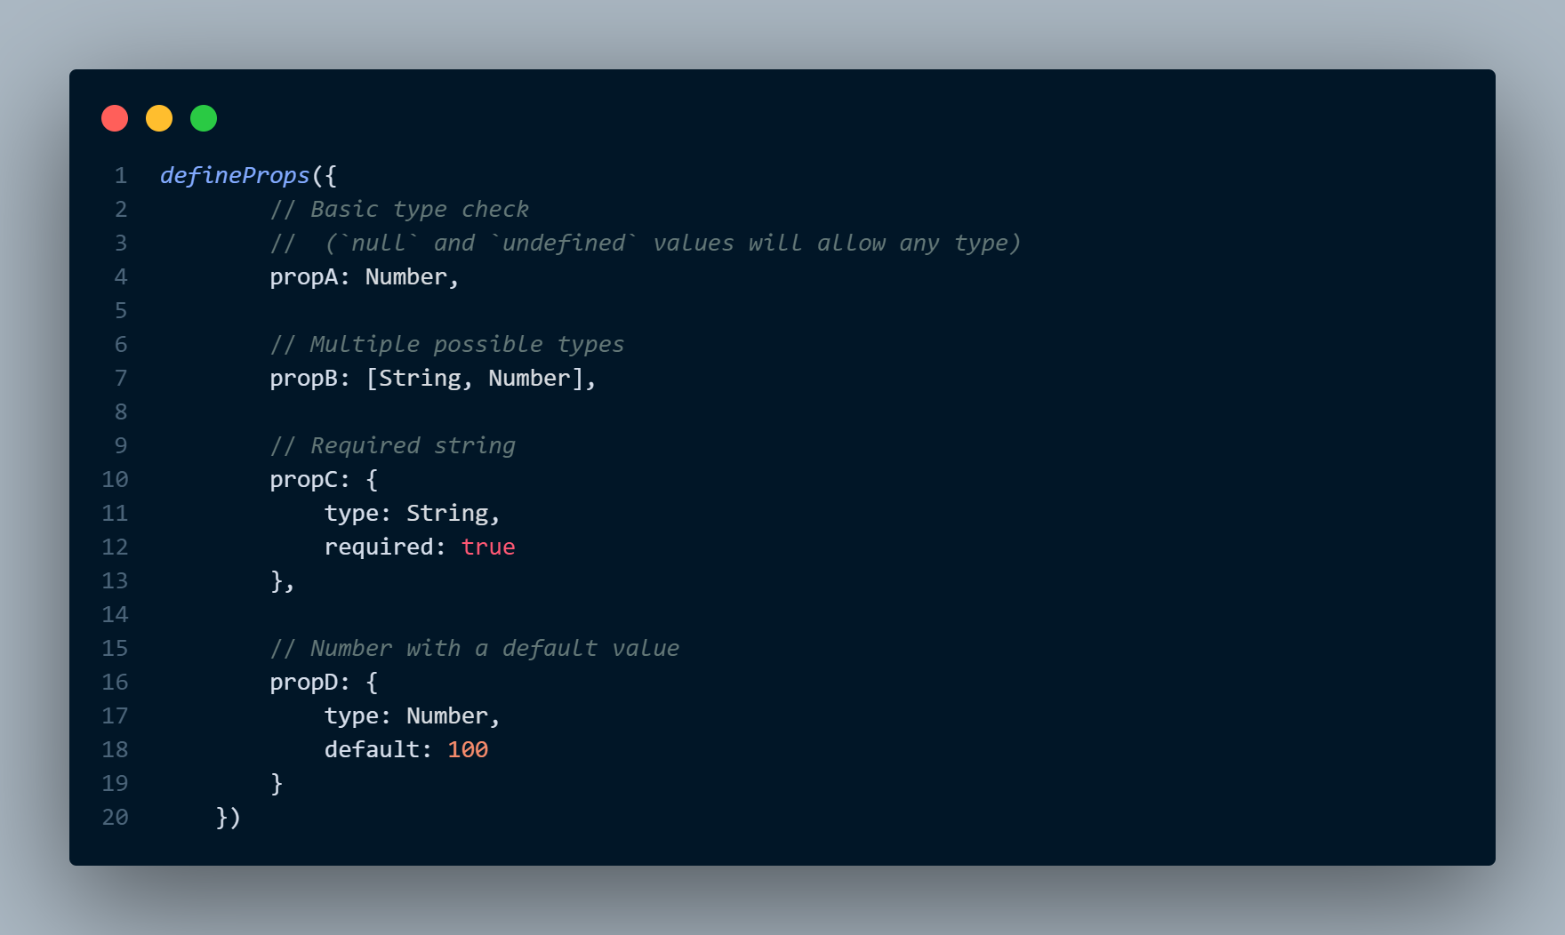
Components (SFC) – Props Validation
Vue.js

Slide 47
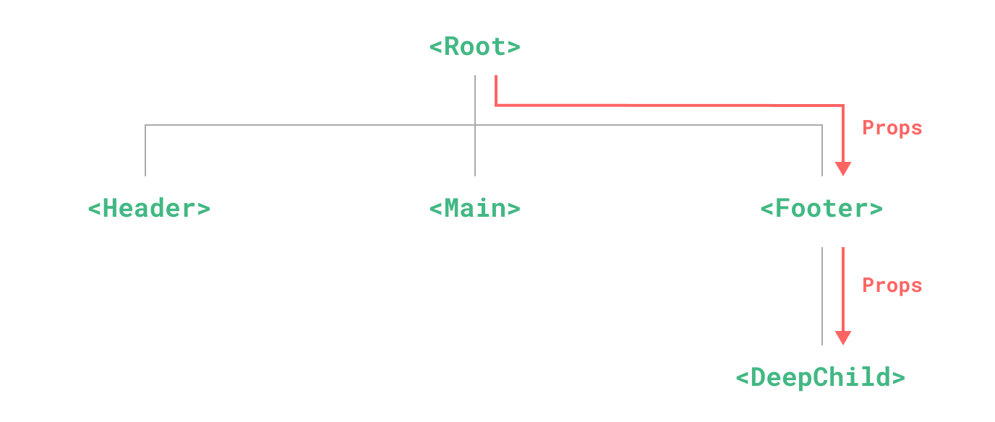
Provide & Inject – Props Drilling
Vue.js

Slide 48
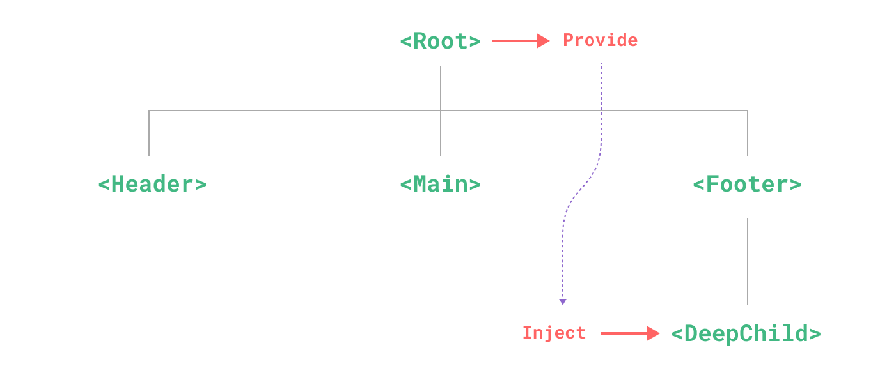
Provide & Inject
Vue.js

Slide 49
Provide & Inject
Vue.js
# Provide – Parent
import { provide } from 'vue'
provide('message', 'hello!’)
# Inject – Descendants
import { inject } from 'vue'
const message = inject('message')
# App-Level Provide
const app = createApp({})
app.provide('message', 'hello!')
Note: The value can be of any type, including reactive state such as refs.

Slide 50
Component Event
Vue.js
Parent
Child
Data, Props
Event, Data

Slide 51
Component Event – Custom Event
Vue.js
# Child Component
<button @click="$emit('someEvent’)”>Click Me</button>
# Parent Component
<ChildComponent @some-event="callback" />
# Event Argument
<button @click="$emit(someEvent', 1)"> Click Me </button>

